Slide 1
Requirement Management Planning
Week 08

Slide 2
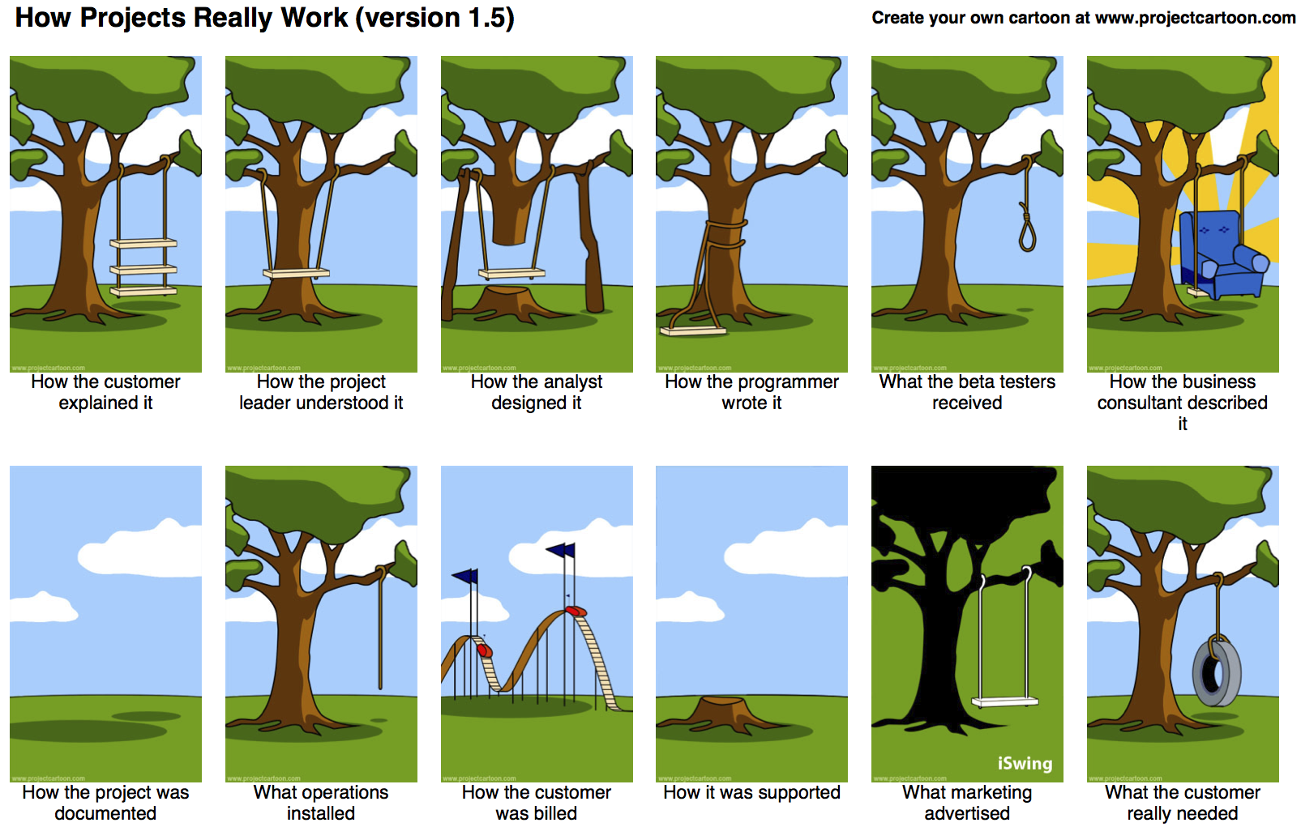

Slide 3
REQUIREMENTS MANAGEMENT PLANNING
Requirements management planning activities occur within the Planning Process Group.
The key benefit of this domain is that it provides guidance and direction on how requirements will be developed and managed throughout the project.
The plan is developed, reviewed, and updated to reflect the specific activities of the life cycle domains from elicitation, analysis, monitoring, and controlling through solution evaluation.
The success factors, planning activities, and tools and techniques are described in Sections 4.1 through 4.3.

Slide 4
4.1 Requirements Management Planning Success Factors
The success factors outlined in Sections 4.1.1 through 4.1.4 are considered vital to maximize the effectiveness of the requirements planning process and increase the likelihood of project success.
4.1.1 Organisational Commitment
4.1.2 Recognizing the Value of Requirements Management Planning
4.1.3 Stakeholder Engagement and Collaboration
4.1.4 Integration with Project Management Activities

Slide 5
4.1.1 Organizational Commitment
Organizational commitment is paramount to the success of any strategic work.
The requirements process should be aligned with the organization's goals and values, and a sponsor should be engaged.
PMI’s annual Pulse of the Profession research report indicates lack of sponsorship support as a leading contributor to project failure.
Therefore, sponsor and stakeholder commitment to the requirements process is paramount during requirements planning.

Slide 6
4.1.2 Recognizing the Value of Requirements Management Planning
Requirements management planning should be recognized as a valuable domain that provides a positive potential return on investment for:
Organizational management
Stakeholders (both internal and external)
Project managers and
Team Members.

Slide 7
4.1.3 Stakeholder Engagement and Collaboration
Stakeholders should be engaged early and often throughout the life cycle.
Stakeholder analysis is often conducted during the planning domain so the project team can understand the stakeholder impacts and influences on the requirements process as early as possible

Slide 8
4.1.3 Stakeholder Engagement and Collaboration
This analysis is performed iteratively and is revisited throughout the project as new stakeholders are discovered or existing stakeholders are determined to no longer be impacted by the proposed solution.
Lack of stakeholder analysis and engagement may lead to incomplete, incorrect, or missed requirements.

Slide 9
4.1.4 Integration with Project Management Activities
Requirements development and management do not exist in isolation from other project management processes.
A successful requirements plan requires integrated execution with the project management plan.

Slide 10
4.2 Requirements Management Planning Activities
Sections 4.2.1 through 4.2.4 cover the four core processes of requirements management planning.
4.2.1 Stakeholder Analysis and Engagement
4.2.2 Requirements Management Planning Initiation
4.2.3 Develop the Requirements Management Plan
4.2.4 Launch the Requirements Management Plan

Slide 11
4.2.1 Stakeholder Analysis and Engagement
Stakeholder analysis and engagement is critical to the success of the requirements management plan.
Stakeholder analysis and identification is the process of Analyzing and identifying the:
People
Groups OR
Organizations that may:
Affect
Be affected by OR
Have an interest in a:
Decision
Activity OR
Outcome of a program or project.

Slide 12
4.2.1 Stakeholder Analysis and Engagement
Stakeholders may be internal or external to the organization.
Further stakeholder identification is conducted during requirements planning activities to set expectations with the key stakeholders to ensure they understand the requirements activities that will be performed and to gain their buy-in and support for the requirements process before work begins.
Stakeholder preferences, characteristics, and expectations inﬂuence requirements management planning decisions.

Slide 13
4.2.1 Stakeholder Analysis and Engagement
The steps involved in the stakeholder analysis are described in Sections 4.2.1.1 through 4.2.1.3.
4.2.1.1 Generate or Refine the Stakeholder Register
4.2.1.2 Group and Characterize Stakeholders
4.2.1.3 Manage Stakeholder Engagement

Slide 14
4.2.1.1 Generate or Refine the Stakeholder Register
An initial stakeholder register may have been developed as a part of the:
Needs Assessment OR
Work to produce the:
Project management plan
Stakeholder management plan
Communications plan OR
Other plan documents.
Whether there is a need to start anew or begin with an existing register of stakeholders, this step analyzes and identifies the stakeholders who will have a role in the requirements process.

Slide 15
4.2.1.1 Generate or Refine the Stakeholder Register
The register may include stakeholders such as those who will:
Provide sponsorship for the project;
Benefit from the project outcomes;
Be responsible for the project outcomes;
Define the product service or result;
Provide support
Articulate the benefits;
Provide financial backing;
Use the solution; and
Implement the solution.
After the register is generated and reviewed, the stakeholders are characterized and grouped.

Slide 16
4.2.1.2 Group and Characterize Stakeholders
Once the stakeholder register is complete, an analysis of the characteristics of the identified stakeholders should be performed.
Some commonly applied characteristics for consideration are:
Attitude
Complexity
Culture
Experience
Level of influence
Location And
Availability.
Brief descriptions of these are in Section 3.3.2 of Business Analysis for Practitioners:A Practice Guide.

Slide 17
4.2.1.2 Group and Characterize Stakeholders
Once characteristics are understood, stakeholders can be grouped.
Groupings can be structured by similar interests, common needs, level of importance, etc., but are used to help identify unique groups for eliciting requirements.
It is important to make sure that there are clear roles, responsibilities, and accountabilities; therefore, a single primary contact should be identified for each task.

Slide 18
4.2.1.2 Group and Characterize Stakeholders
A commonly used approach to organizing these assignments, known as either RACI or ACRI, characterizes and groups stakeholders into one or more of four categories:
Responsible: Person(s) performing the work.
Accountable: Person(s) approving the work or assigning a delegate to approve for them.
Consulted: Person or group (often subject matter experts) to be consulted for input.
Informed: Person or group to be apprised of progress.

Slide 19
4.2.1.2 Group and Characterize Stakeholders
Some expansions are RASIC or CAIRO:
Support: Person(s) who will support Responsible.
Omitted: Person(s) who are not part of the task

Slide 20
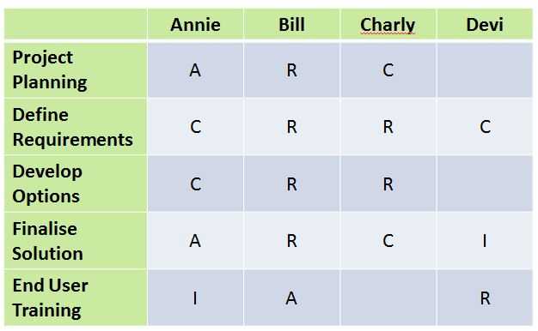
4.2.1.2 Group and Characterize Stakeholders

Slide 21
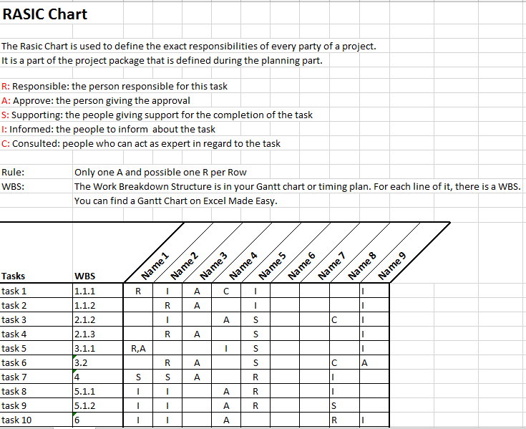
4.2.1.2 Group and Characterize Stakeholders

Slide 22
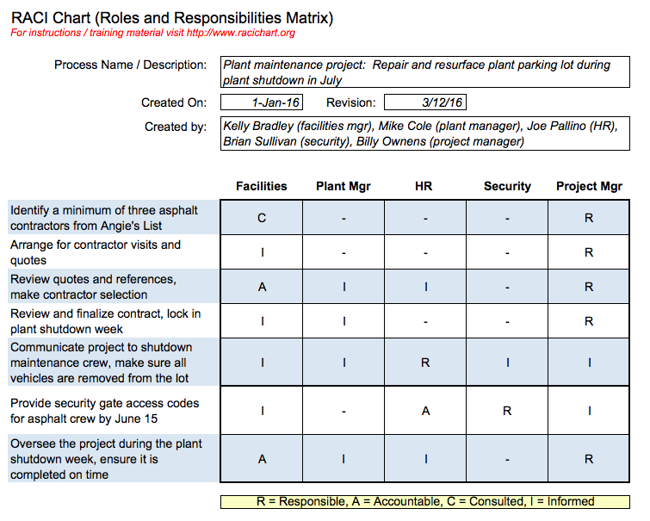
4.2.1.2 Group and Characterize Stakeholders

Slide 23
4.2.1.2 Group and Characterize Stakeholders
Once the stakeholder register is reviewed and approved, the information collected in this step can be later documented in the requirements management plan.
As stakeholders change over the course of the project, the register is updated to reflect the current stakeholders.

Slide 24
4.2.1.3 Manage Stakeholder Engagement
Through proactive communication and working directly with stakeholders to meet the project objectives, stakeholders are engaged and managed throughout the requirements life cycle process.
It is important to:
Understand their needs and expectations
Address issues as they arise And
Foster the appropriate engagement throughout the life cycle in order to:
Gain increased support And
Reduced resistance
To significantly increasing the chance to achieve project success.

Slide 25
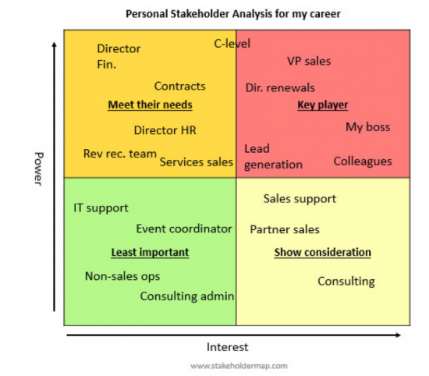
4.2.1.3 Manage Stakeholder Engagement

Slide 26
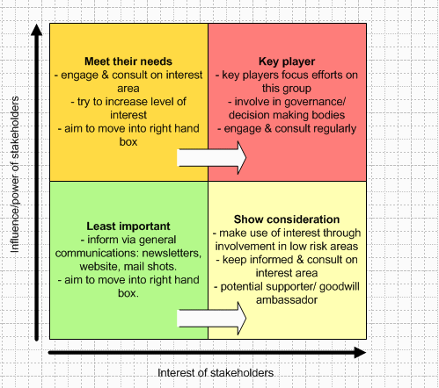
4.2.1.3 Manage Stakeholder Engagement

Slide 27
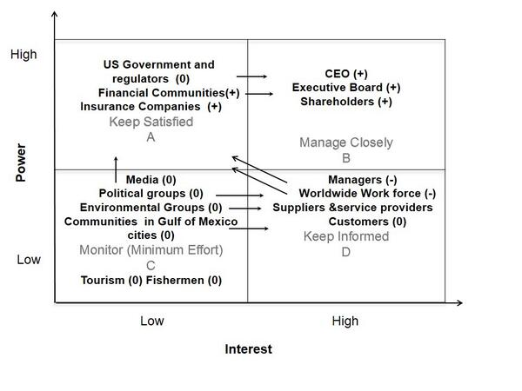
4.2.1.3 Manage Stakeholder Engagement

Slide 28
4.2.2 Requirements Management Planning Initiation
Generally, there is a list of project artifacts that describe the project.
It is essential at the start of the requirements process to clearly understand the initial project scope statement and project objectives.
The key tasks for initiating requirements management planning are described in Sections 4.2.2.1 and 4.2.2.2.
4.2.2.1 Gather Project Information
4.2.2.2 Identify Organizational Standards and Guidance

